Slide 1
MiniLudu
Sandford Harris & Hasibullah Ghulamhaidar

Slide 2
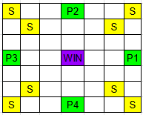
Game overview & requirements
Played with 4 players. Each player starts on their own starting square and take turns rolling a 4 sided dice.
Players landing on the same empty space (white sqaures) as another player will kill them, sending them back to their initial starting position (green squares)
Players on safe spaces (yellow and green squares) cannot be killed.
Each player moves anti-clockwise around the edge board from their starting location, and clockwise around the inside of the board.
Players landing on the centre square (purple) win the game. Play continues until 3 players have won.
Players must roll the exact number to reach the end, otherwise play passes to the next player.
The game must be implemented using a double linked list

Slide 3
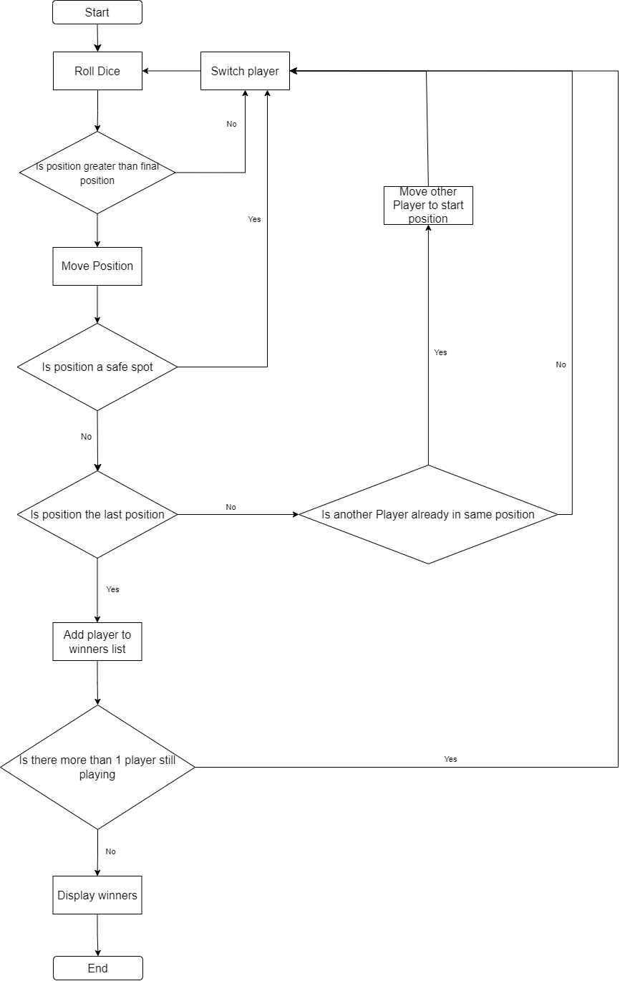
Program flowchart

Slide 4
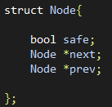
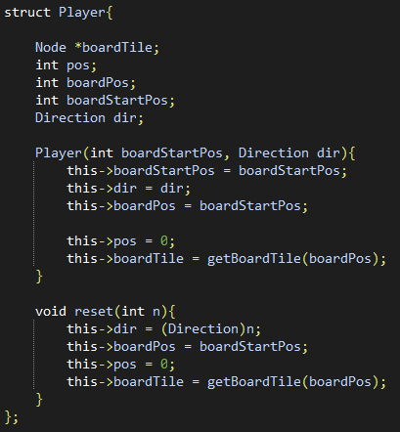
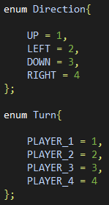
Initialisation
Node struct
Pointers to next and previous Nodes
Bool safe – if the node is a safe spot or not
Player struct
Node *boardTile – reference to player's location in the list
Int pos – how close player is to its goal
Int boardStartPos – node player starts at on the board
Int boardPos – player's current node on the board
Direction dir – enum tracking which way the player moves across the board
Reset() - sets player attributes to initial values
enum Direction – can be UP, DOWN, LEFT or RIGHT
enum Turn – keeps track of player turn. Can be PLAYER_1, PLAYER_2, PLAYER_3 or PLAYER_4

Slide 5
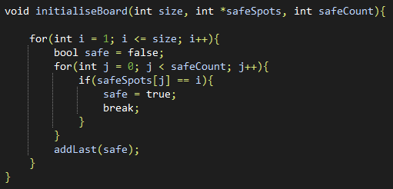
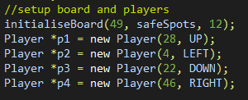
Initialisation
Int safeSpots[] - which tiles on the board should be considered safe
Int turningPoints[] - when the player should changed direction of traversal
InitialiseBoard() - creates the linked list with a given number of nodes, assigns safe spots according to safeSpots[]
Dice rolls done using rand()
Seeded using time with srand(time())

Slide 6
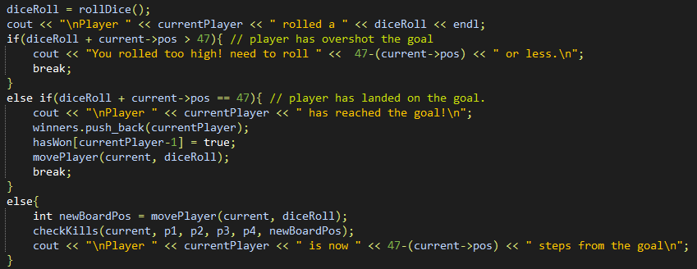
Main loop
Player can roll or exit
Dice is rolled
if player overshoots end
Pass turn
if player lands on end
Add to winners list
move the player amount rolled
Check if the player kills

Slide 7
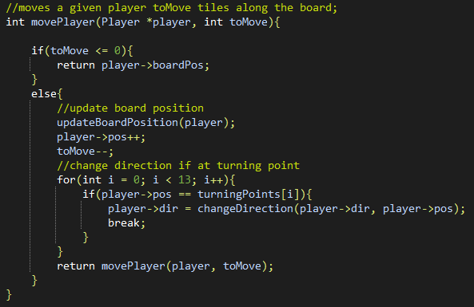
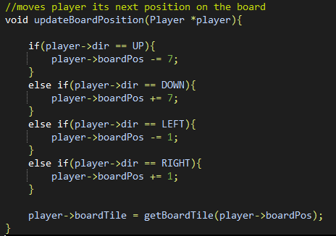
Moving the player
MovePlayer()
Recursive
Moves player step by step
Changes player direction if they land on a turning point
Updates player boardPos, pos, and tile reference
UpdateBoardPosition()
Sets player's board position based on its current direction

Slide 8
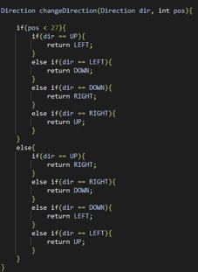
ChangeDirection()
ChangeDirection()
Returns a new direction for the player to move in based on current direction and the player's current position
Controls when the player switches from anti-clockwise to clockwise

Slide 9
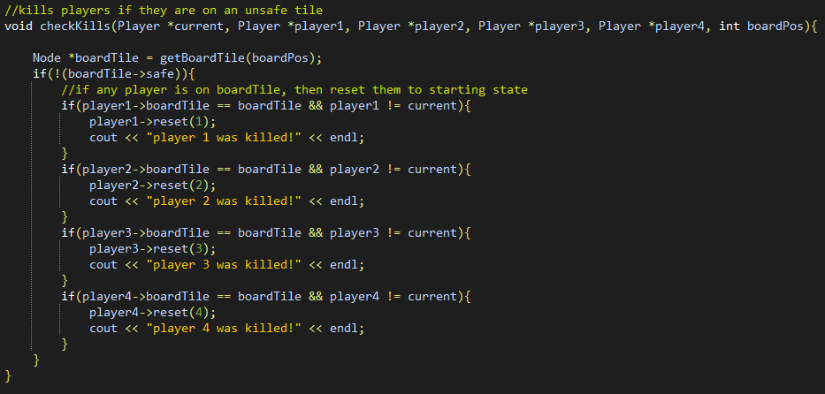
CheckKills()
Takes a reference to all players and current player and the board position
If the tile at that position isn't safe and a player on that tile is not the current player, they are killed
Killed players are reset to their starting position

Slide 10
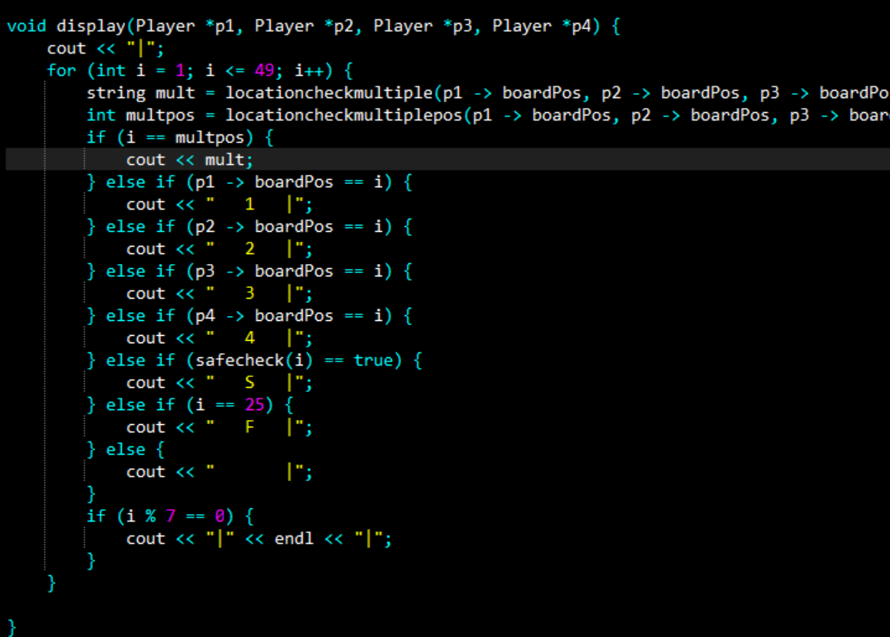
Displaying the board
display() – the function will display the board of the game along with where the players are and where the safe spots are located
mult – used if there is more than one player in a position
multpos – gives the position where more than one player is in

Slide 11
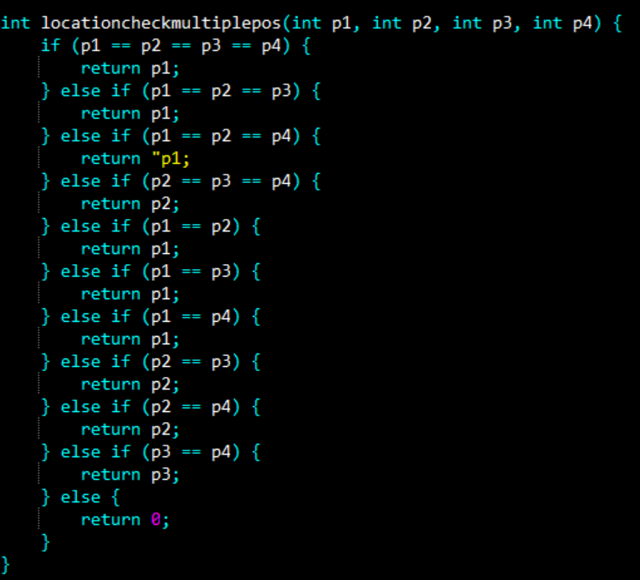
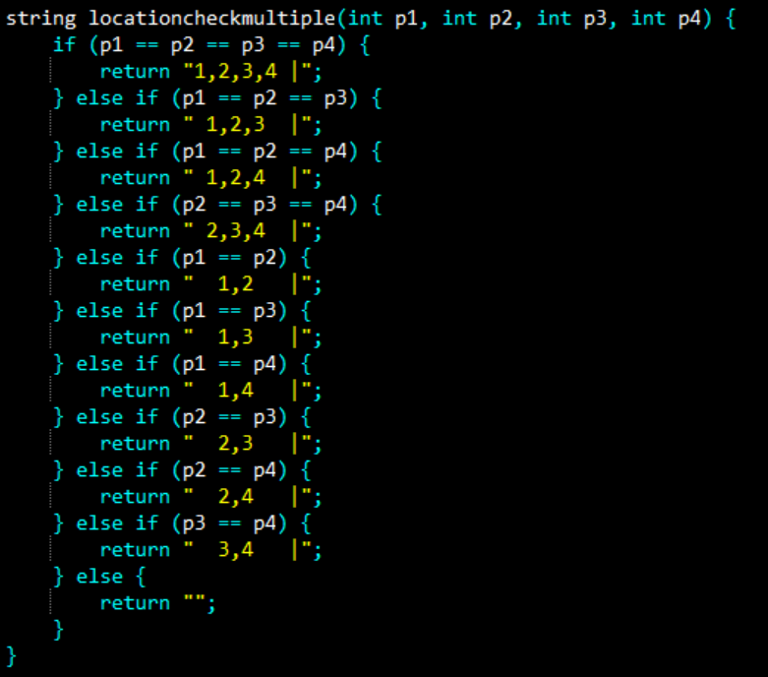
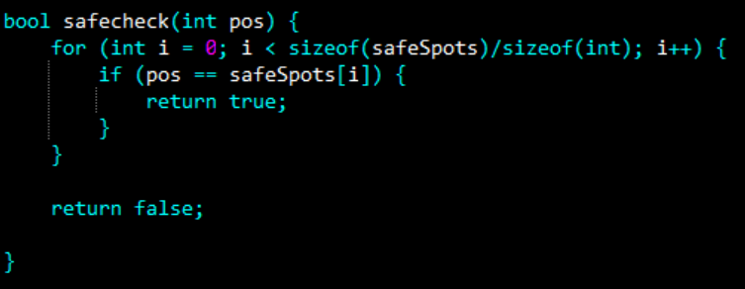
Displaying the board
locationcheckmultiplepos() – returns the position where there is more than one player, given that the position is a safe spot.
locationcheckmultiple() – gives a string that shows the players at a position if there is more than one, and if the position is a safe sport
safecheck() – checks to see if a given position is a safe spot

Slide 12
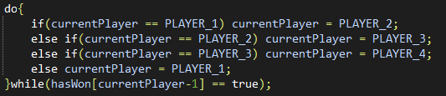
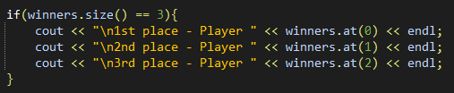
Winning the game
Next player chosen from those who havent reached the end
When 3 players have reached the end, the game ends
Output winners in the order they were added

